Slide 1
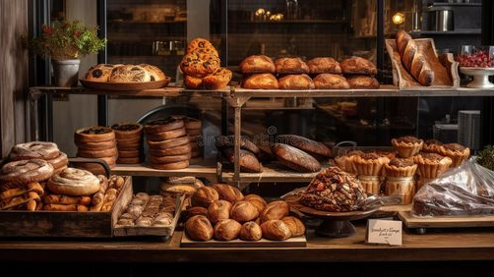
Bakery Management System
BY: Parvati
Reg No: 12215266
Roll No: 53
Teacher:Mr kedar nath singh

Slide 2
introduction
The Bakery Management System is a streamlined web application built with React.js, designed to enhance the customer experience by providing an intuitive platform for browsing and ordering bakery products. This system includes core features such as a Home page to introduce the bakery's offerings, a Menu displaying a variety of items with descriptions and prices, a Cart for easy selection and management of orders, and a Contact Us section for customer inquiries. By combining essential functions into a cohesive interface, the Bakery Management System delivers a responsive and user-friendly experience, making it easier for customers to explore products and place orders efficiently.

Slide 3
total PAGES
HOME PAGE
MENU PAGE
CART PAGE
CONTACT
LOGIN PAGE
ABOUT US PAGE

Slide 4
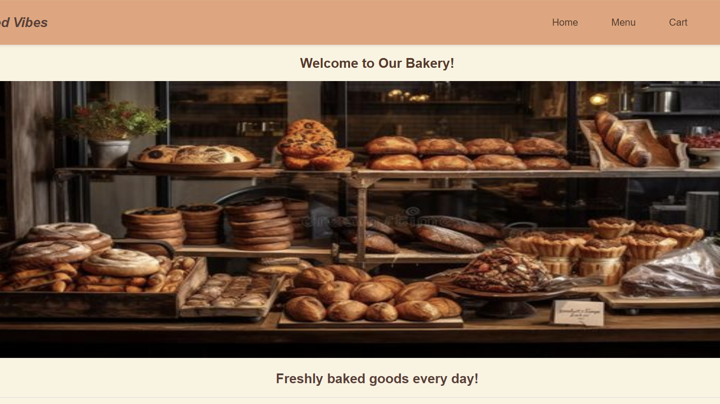
Home PAGE

Slide 5
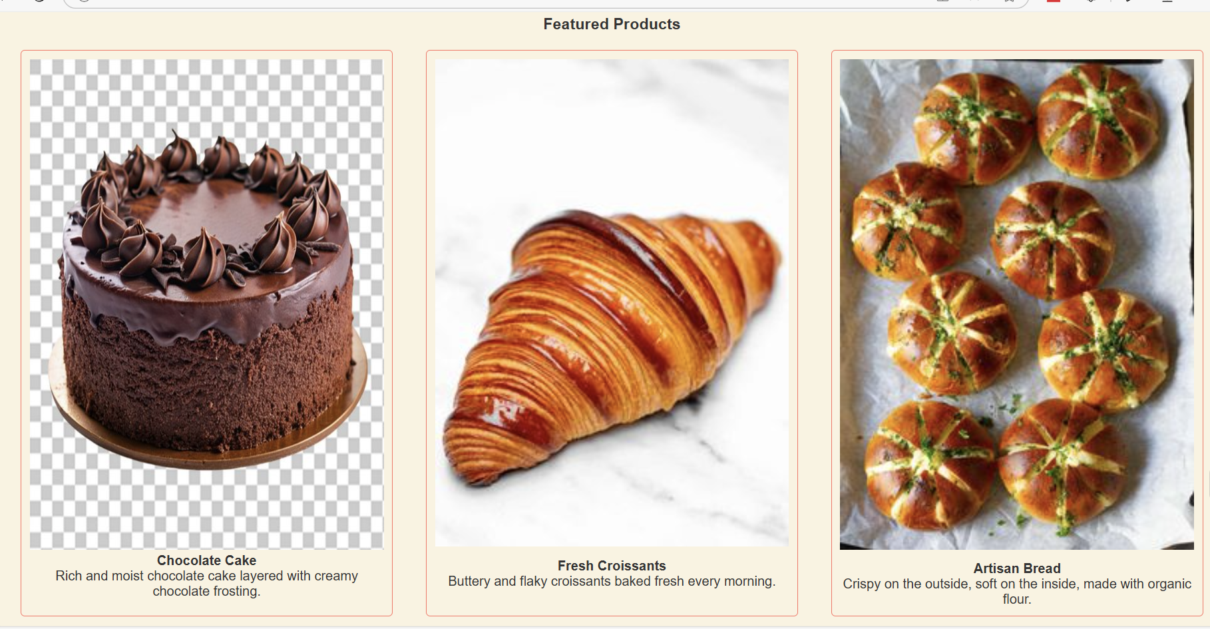
About us page

Slide 6
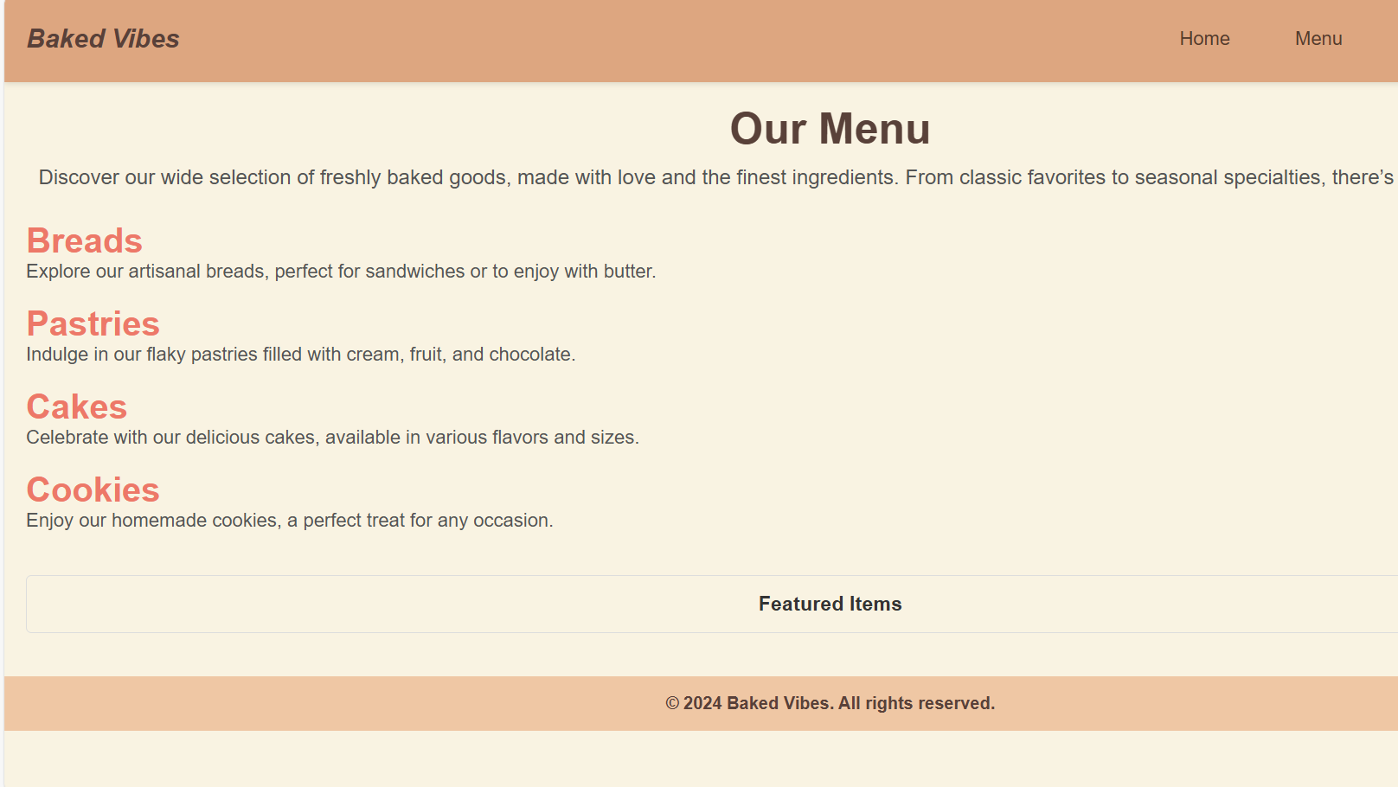
MENU page

Slide 7
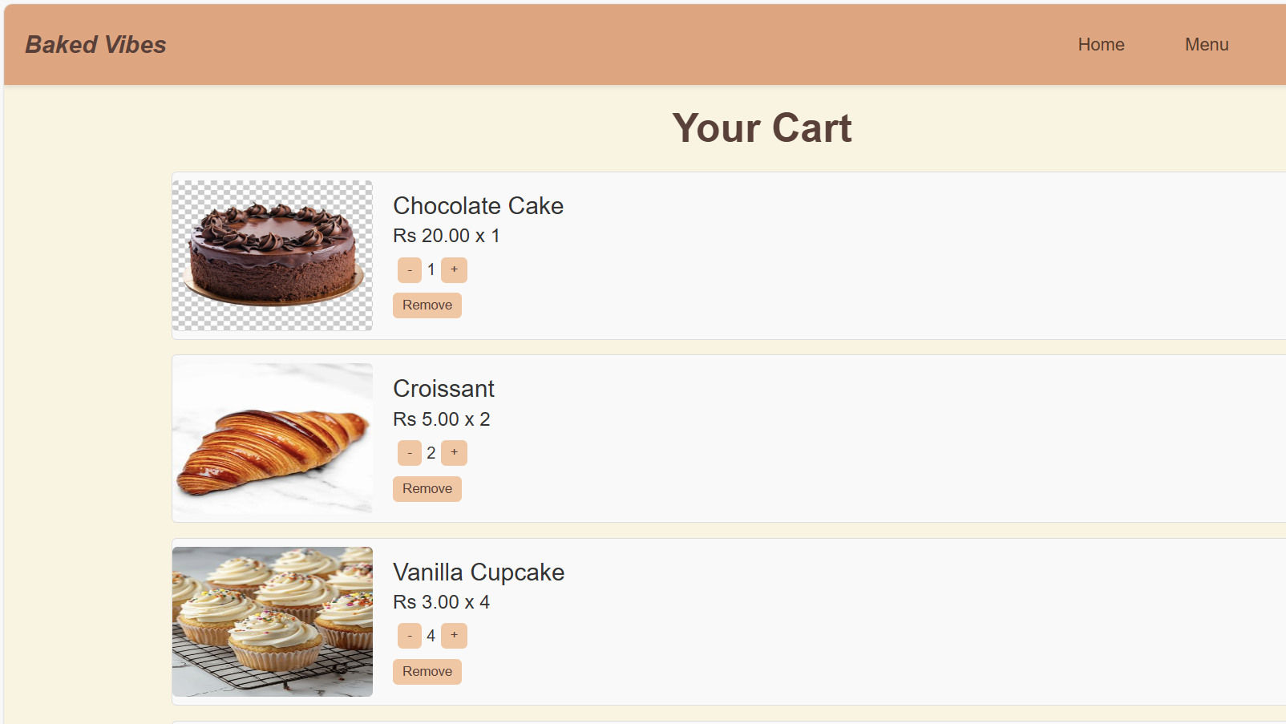
Cart page

Slide 8
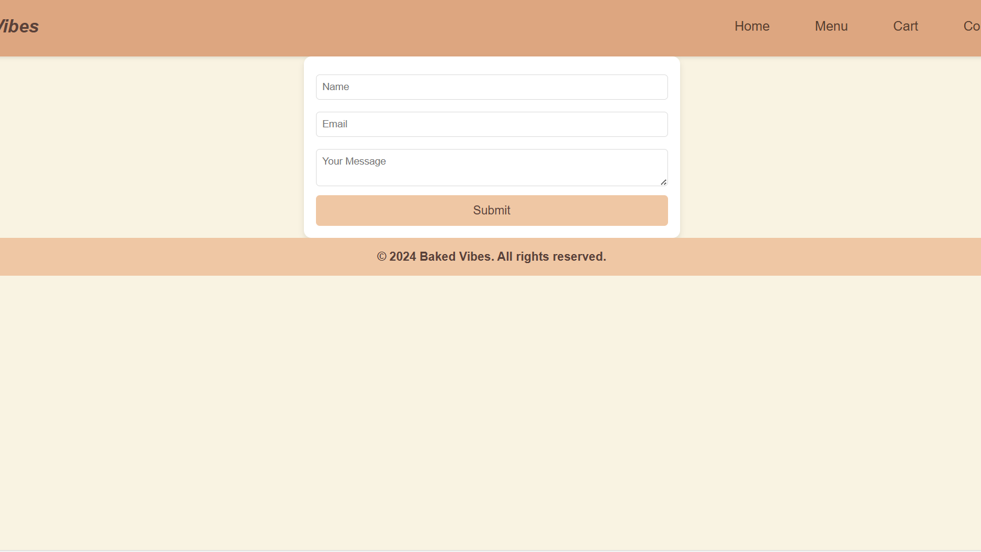
Contact us

Slide 9

CODE:-

Slide 10
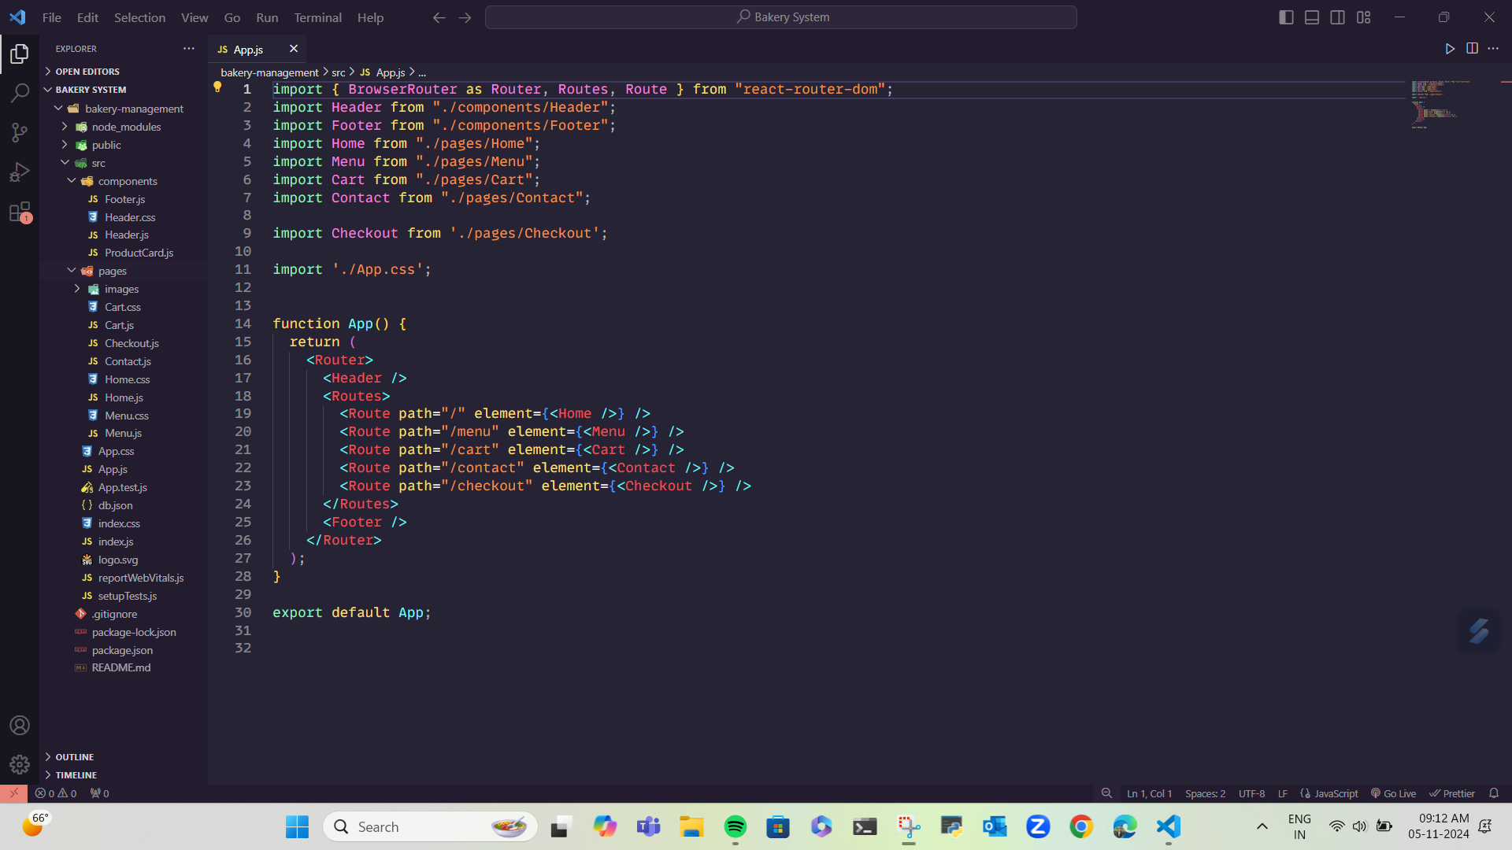
CODE:-
10

Slide 11
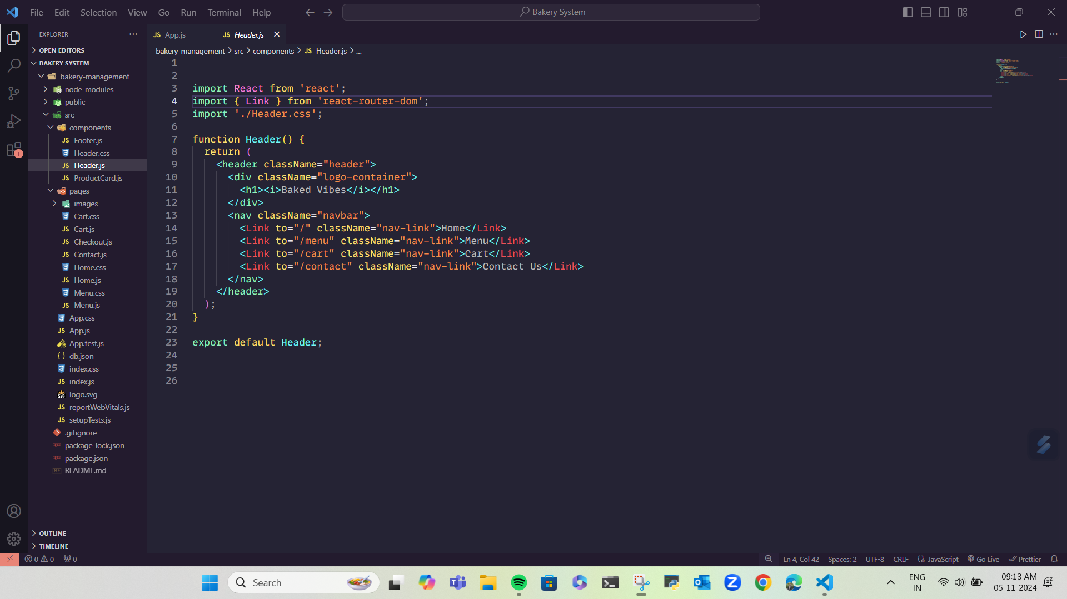
CODE:-
11

Slide 12
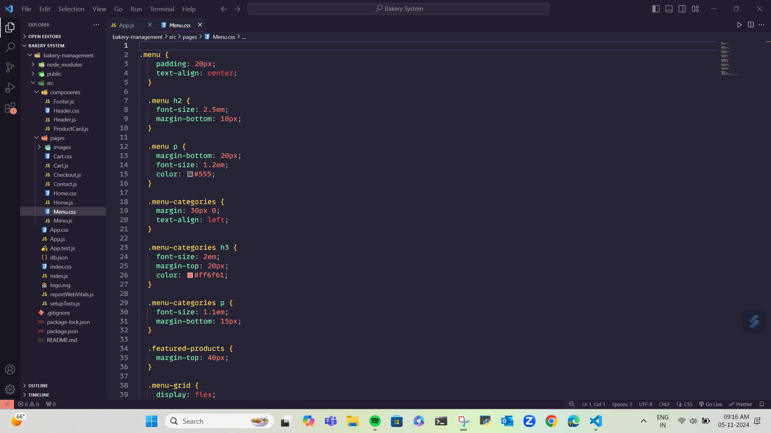
CODE:-

Slide 13
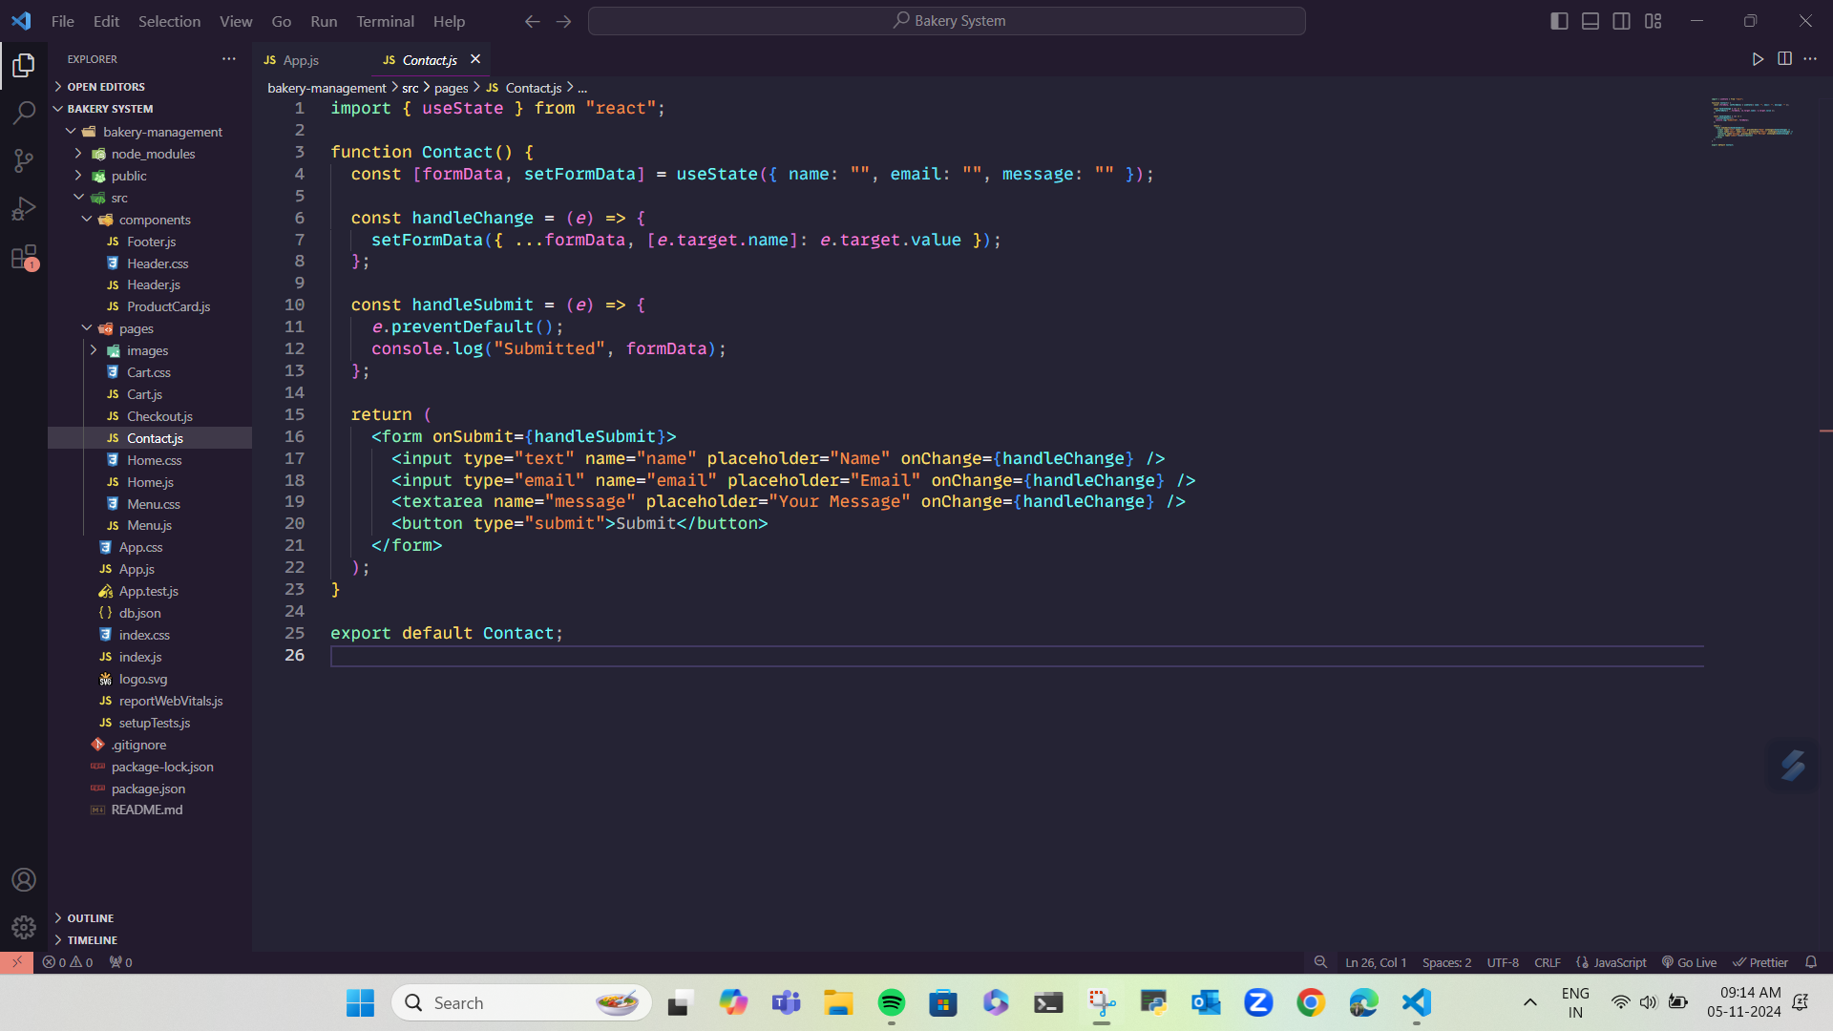
CODE:-
13

Slide 14
Future work
•Customer Reviews and Ratings: Allow customers to leave feedback on products, which can help improve bakery services and guide new customers.
• Analytics Dashboard: Create a dashboard for the bakery to view sales trends, popular items, and customer demographics, which can inform business strategies and inventory planning.
• Advanced Order Tracking: Integrate a system for customers to track the status of their orders in real time, from preparation to delivery or pickup.

Slide 15
CONCLUSION
In conclusion, the Bakery Management System built with React.js offers a comprehensive, user-friendly solution for managing bakery orders and enhancing customer interactions. With features such as a welcoming Home page, detailed Menu, convenient Cart, and accessible Contact Us section, the system effectively simplifies the browsing and purchasing process. This project not only highlights the potential of single-page applications in e-commerce but also provides a solid foundation for future enhancements, such as user accounts, payment integration, and advanced order tracking, which could further enrich the user experience and operational efficiency of bakery businesses

Slide 16

Thank you

